Slide 1
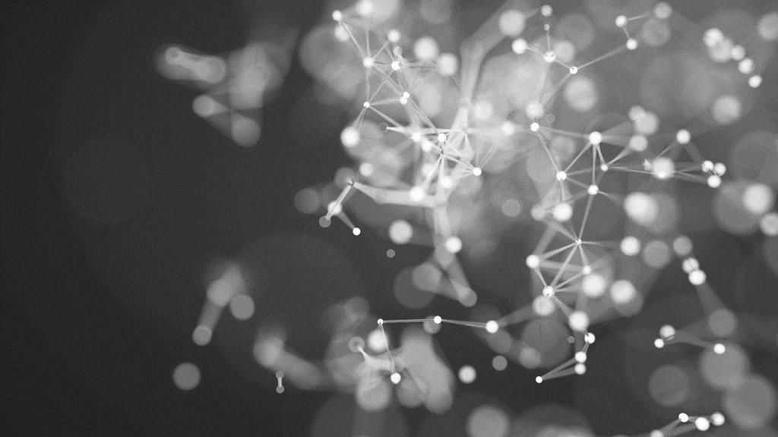
Deep learning and cosmological structure formation
pHYS 449
François, Tristan, Cyrus, & Finn
1.11.21

Slide 2
Lucie-Smith, L., Peiris, H. V., Pontzen, A., Nord, B., & Thiyagalingam, J. (2020). Deep learning insights into cosmological structure formation. arXiv preprint arXiv:2011.10577.
Notes:
Citation for arXiv version. No journal version available on google scholar. (https://www.osti.gov/biblio/1765967?fbclid=IwAR3amU4svffFHh1hn6q9tlF8L8BGm1vUXT0nQvw_SAQvbVmFRLkD9LRzIdA) "Journal: TBD"
Last updated October 25!

Slide 3
1 | Problem statement

Slide 4
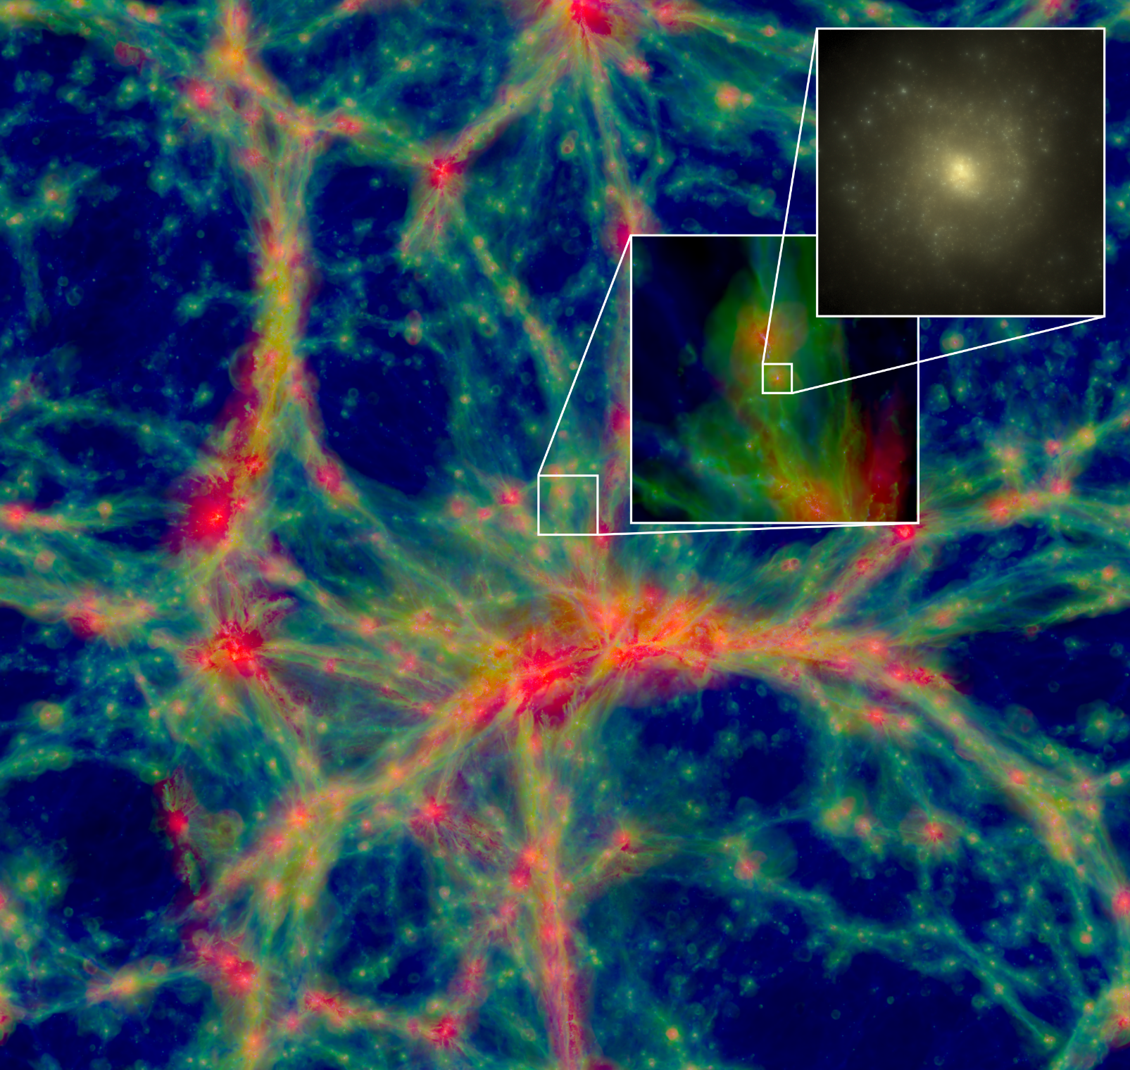
Large-scale structure
Emergent from small scale anisotropies in early universe + gravitational collapse
Universe is a 'cosmic web': halos of dark matter (DM), connected by filaments
Evolution of this structure constrains cosmology!
Gas temperature slice of EAGLE simulation+zoomed in halo+galaxy (from:http://icc.dur.ac.uk/Eagle/ )

Slide 5
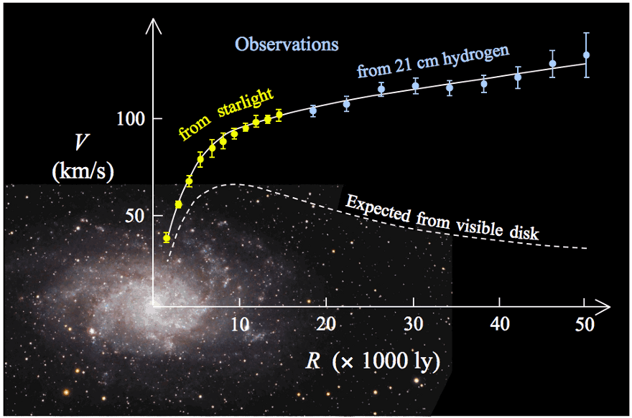
Dark matter
Accounts for 26.8% of mass-energy of the universe [Planck collaboration,2013]
Galaxy rotation curve --> dark matter accounts for gap in observations!
Dark matter halos contain galaxies, and can be described through their mass, spin, etc.
Figure: Observed vs expected galaxy rotation curve –
from Forbes (https://www.forbes.com/sites/startswithabang/2016/12/28/finding-darkness-in-the-light-how-vera-rubin-changed-the-universe/?sh=192cd3f415eb)

Slide 6
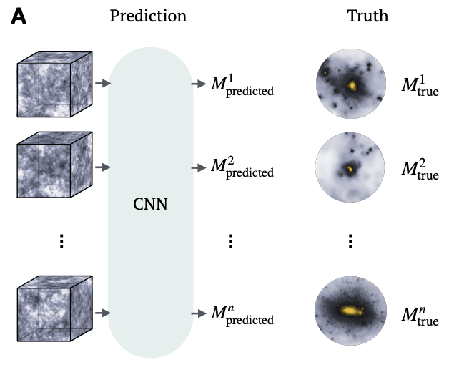
Structure formation
Current challenge: Taking linearized evolution in density fluctuations to produce the structure seen today
Applying this model to clusters of galaxies, extracting cosmological info
This paper: Given a box of initial conditions, predict M_{halo} using a 3D CNN
Heuristic summary of the paper: given some box of initial conditions, predict the final halo mass from GADGET simulations. Figure from L.Lucie-Smith et al. 2020

Slide 7
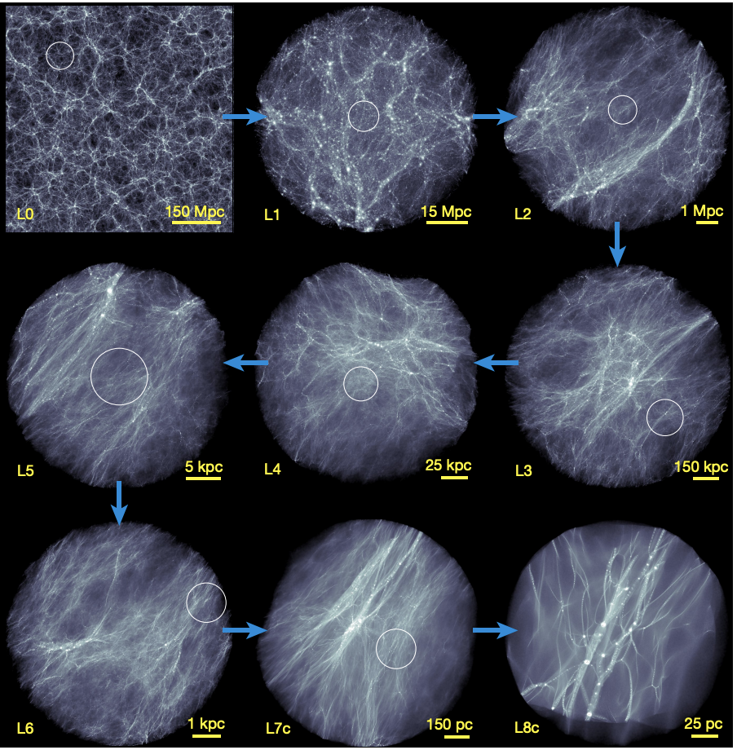
The Data
20 Dark-matter-only P-GADGET-3 N-body simulations, box size of L =50 Mpc/h, initial conditions from z = 99, N = 256³ particles, h = 0.71
Examined halos at narrowed range of log(M/M_{star}) in [11,13.4]
Ground truth data: dark matter halo particles at last snapshot (z = 0)
Zoom-in snapshots of projected dark matter density from the 2005 Millenium Simulation from: Wang, J., Bose, S., Frenk, C.S. et al. (2020)

Slide 8
2 | Methodology

Slide 9
EXISTING TECHNIQUES
Computational State-of-the-art (non-ML):
N-body simulations
Traditional ML:
Gradient-Boosted Tree (GBT, used in previous work)
Other works train 3D CNNs to infer global quantities:
cosmological parameters, abundance of galaxies, displacement field across the entire simulation at 𝑧 = 0
or to act as fast N-body surrogates.
Notes:
Unsurprising, given the similar performance to GBT

Slide 10
This paper
Physical interpretation of non-linear dynamics in N-body simulations is lacking
Aim: leverage ability of DL models to learn non-linear mappings as well as interpretation techniques to try and gain new insight into gravitational halo collapse.
Notes:
Unsurprising, given the similar performance to GBT

Slide 11
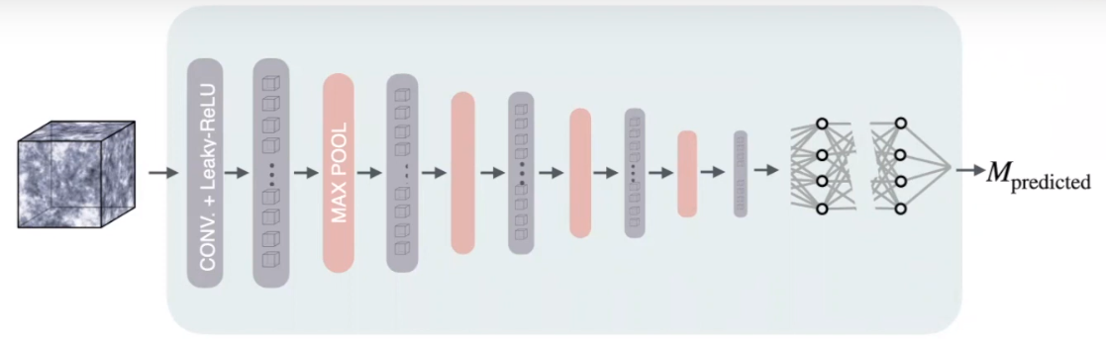
Architecture
3D CNN
2 | Methodology
Figure: Cosmology From Home Conference (https://www.youtube.com/watch?v=tgxoDsP6RsA)
Notes:
For a given simulation particle. Input is sub-volume centered on particle's initial location

Slide 12
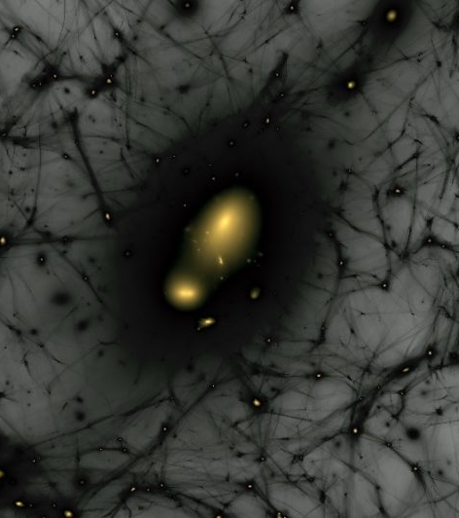
Architecture
Why Deep Learning?
No manually extracted features --> no bias introduced
Can add physical insight
Why CNN?
Translational invariance
Suited to 2D/3D (spatial) data
Figure: Fermilab (https://news.fnal.gov/2020/04/the-milky-ways-satellites-help-reveal-link-between-dark-matter-halos-and-galaxy-formation/)

Slide 13
ARCHITECTURE
Input
Input = subset of initial density field centered on particle in consideration
Cubic box of size 𝐿 = 15 Mpc/h
Resolution = 75^3
Density is averaged within each voxel
Output
Single output neuron: gives the predicted mass
The ground truth mass is rescaled to [-1,1]
Notes:
This is what they ended up with

Slide 14
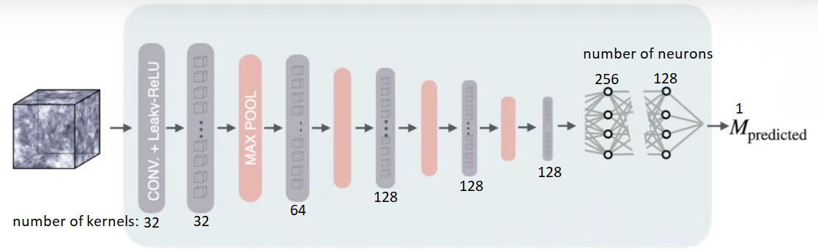
3D CNN:
6 convolutional layers
3x3x3 kernels
Leaky ReLU
Max pooling
3 fully-connected layers
2, 108, 258 trained parameters
Notes:
This is what they ended up with

Slide 15
3D CNN
Convolution layers: feature extraction
E.g. the first layer learns features on scales of 0.6 Mpc
Fully-connected layers: analyze the features
Notes:
This is what they ended up with

Slide 16
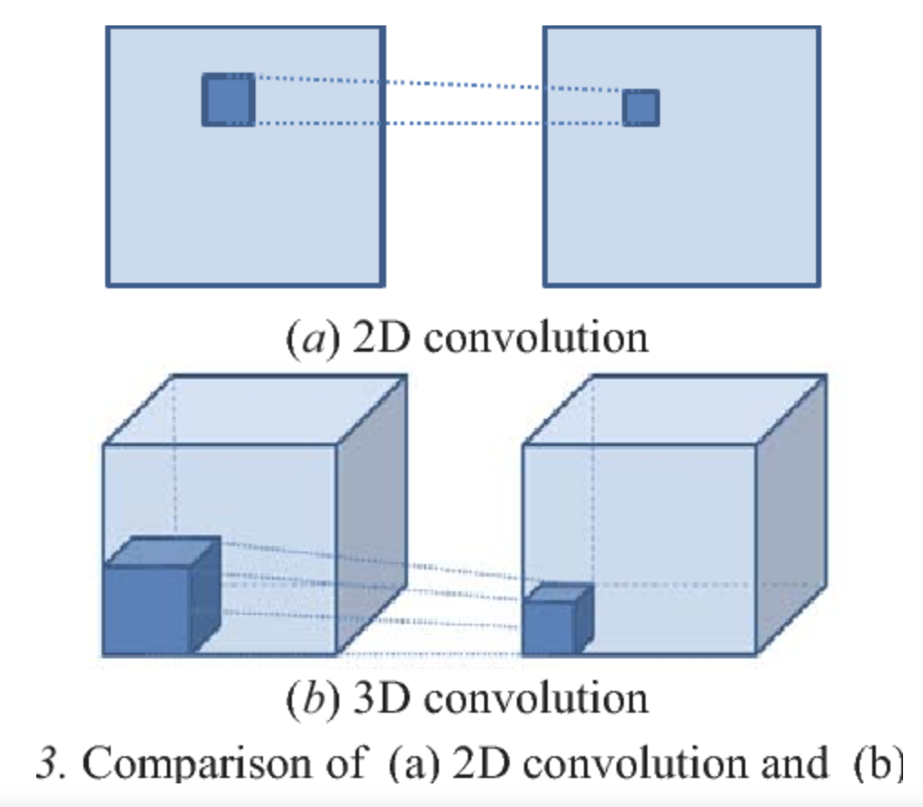
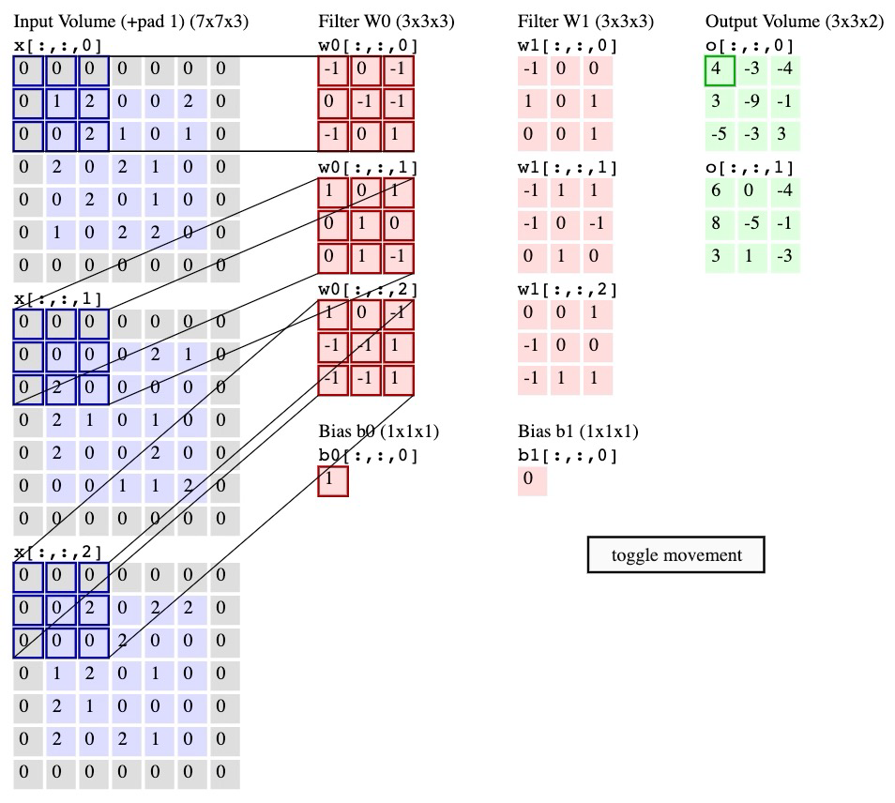
3D CONVOLUTION
Analogous to 2D convolution
from: Lung nodule detection based on 3D convolutional neural networks, Fan et al
from: http://cs231n.github.io/convolutional-networks/Lung nodule detection based on 3D convolutional neural networks, Fan et al
Notes:
This is what they ended up with

Slide 17
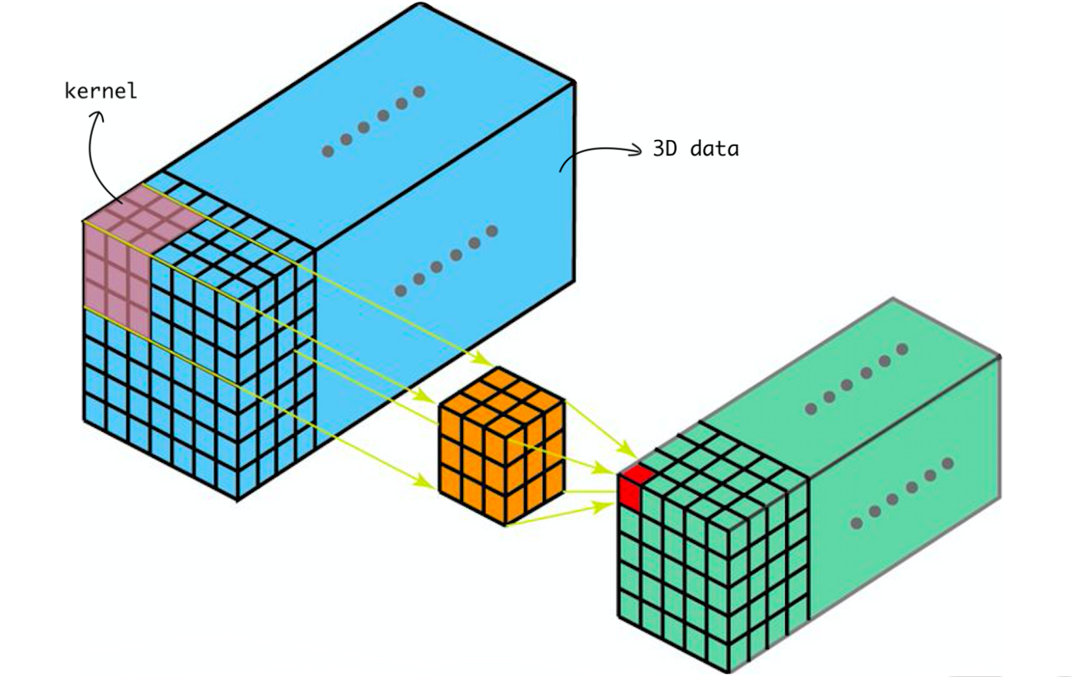
3D CONVOLUTION
The kernel, output are both 3D (cube-like)
from: https://towardsdatascience.com/understanding-1d-and-3d-convolution-neural-network-keras-9d8f76e29610
Notes:
This is what they ended up with

Slide 18
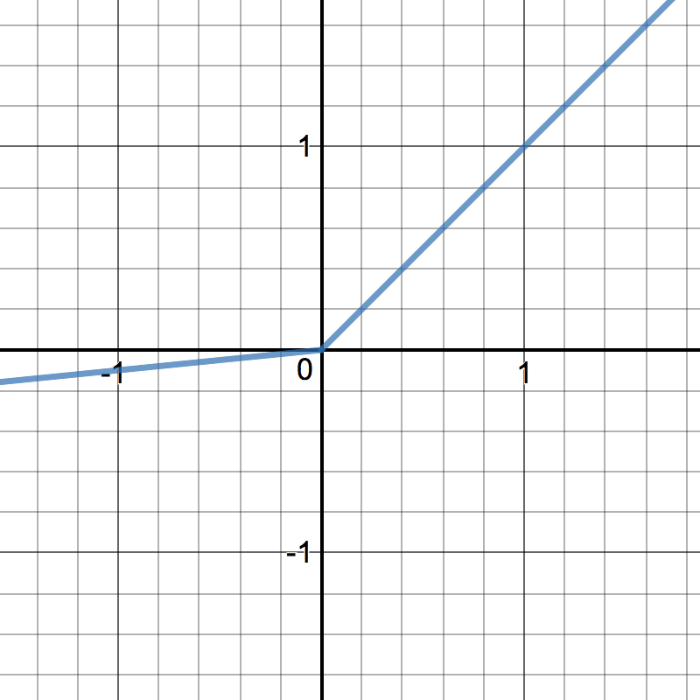

LEAKY ReLU
Applied to every convolutional and fully-connected layer except for the last one
solves the dead ReLU problem
β = 0.03
from: https://www.iamsiddharth.com/ML-Cheatsheet/
Notes:
This is what they ended up with

Slide 19
Architecture
Things that the authors tried (but did not use due to similar/inferior performance)
Batch-normalization layers
Dropout
Adding/removing convolutional layers and/or fully-connected layers
Increasing/decreasing the number of kernels/neurons in each convolutional/fully-connected layer

Slide 20
Architecture
(continued)
Changing the weight initializer
Changing the convolutional kernel size

Slide 21
Architecture
On the training side, they tried...
Adding an additional 300,000 particles from another independent simulation
Re-balancing the training set to have the same number of particles in low- and high-mass halos
Use the gravitational potential as the input instead of the density field

Slide 22
TRAINING
200,000 particles, randomly drawn from 20 simulations with different initial conditions
Batch size = 64 particles

Slide 23
TRAINING
Optimizer: AMSGrad (variant of Adam)
Learning rate optimized via cross-validation
Early-stopping after around 25,000 iterations

Slide 24
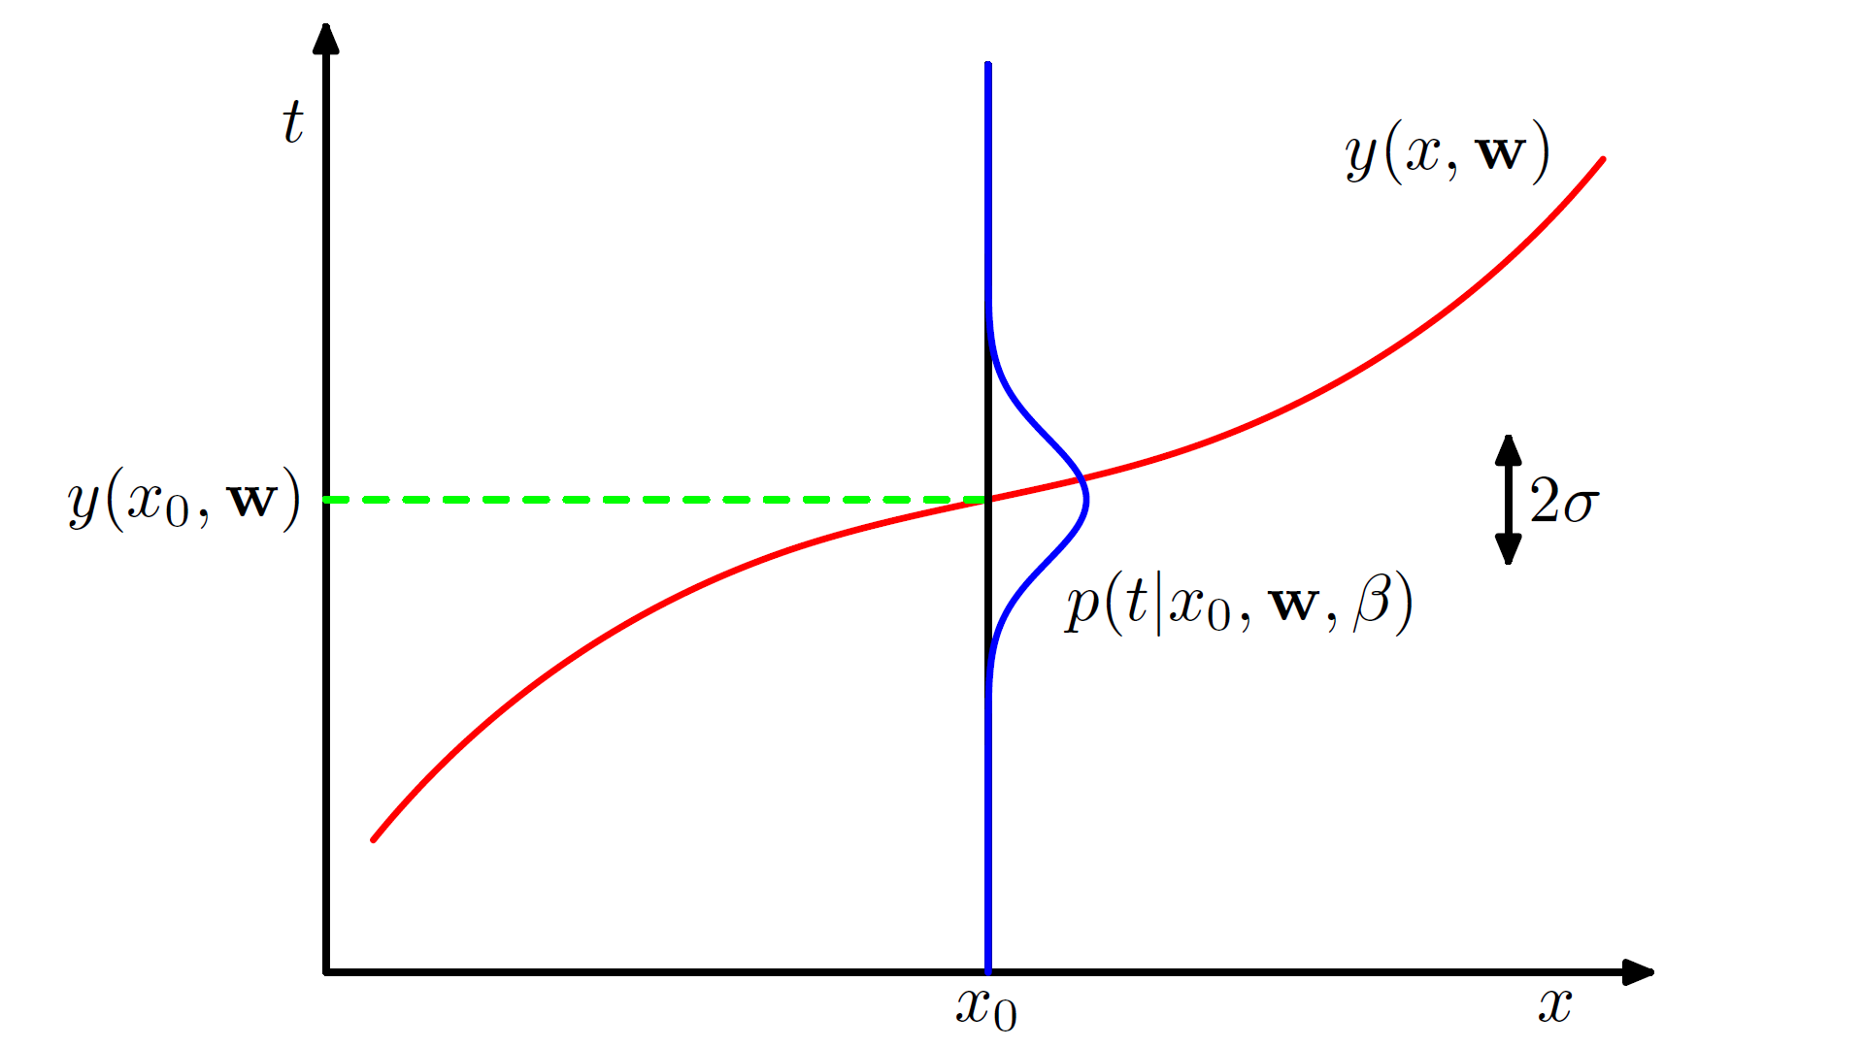
CUSTOM LOSS FUNCTION
Maximum Likelihood Estimation
Assume the true data is the sum of the model plus noise
We can calculate the probability of obtaining the noise we need to fit the data
But what probability distribution should we use?
from: BISHOP, M. (2016). Pattern recognition and machine learning. SPRINGER-VERLAG NEW YORK.
Notes:
This is what they ended up with

Slide 25
CUSTOM LOSS FUNCTION
Motivation
The authors assumed a specific loss function and trained the CNN
Confirmed the choice via comparison of the true data with the predicted values
Notes:
This is what they ended up with

Slide 26
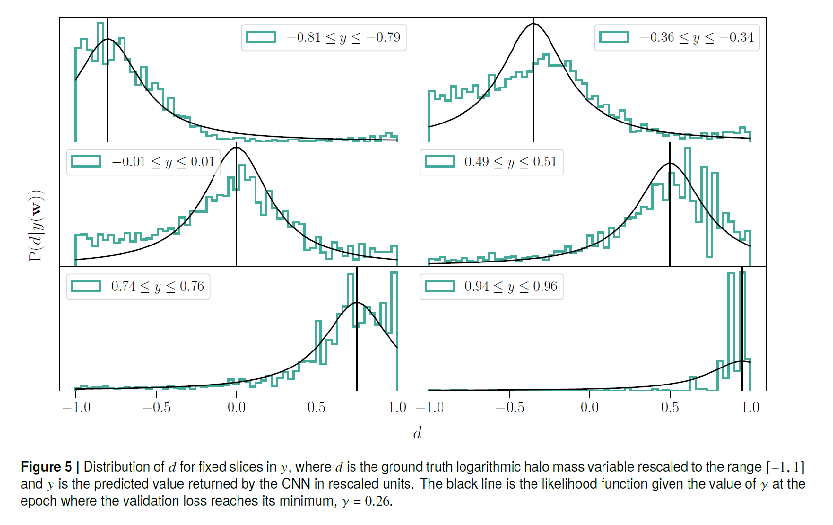
from L.Lucie-Smith et al. 2020​
Sort the particles into bins according to their predicted mass
Their true mass spreads throughout [-1,1]
x-axis is the true mass value, y-axis is the frequency/probability

Slide 27
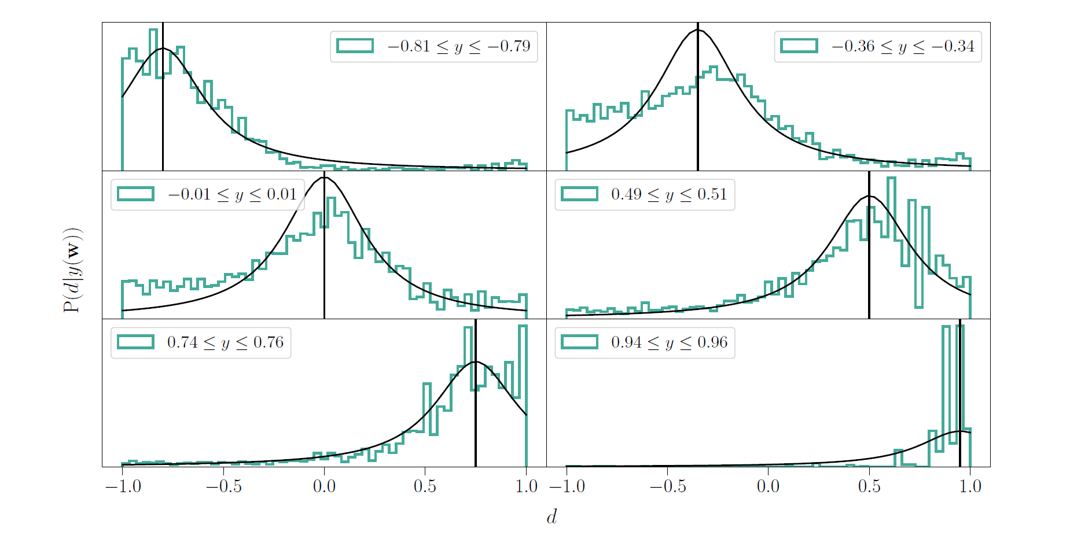
Gaussian distribution cannot account for the long tails (eg around y = 1 and y = -1)
Choose the Cauchy distribution function for the likelihood
Notes:
This is what they ended up with

Slide 28

Negative log-likelihood for the Cauchy distribution
𝛾 determines the half-width at half-maximum of the Cauchy distribution
Optimized during training (since its optimal value is not known)
(Notice the similarities with the mean square error for the Gaussian distribution.)
(We omit additional terms in the loss function that arise since we restricted the ground truth to [-1,1])
Notes:
This is what they ended up with

Slide 29
REGULARIZATION
L2 regularization for the convolutional layers
L1 regularization and Group Lasso for the fully-connected layers
Group Lasso
Promotes group-level sparsity,
I.e. encourages all variables in a group to be simultaneously zero or non-zero
Here, a group = all output weights associated with a single neuron
Notes:
This is what they ended up with

Slide 30
3 | results

Slide 31
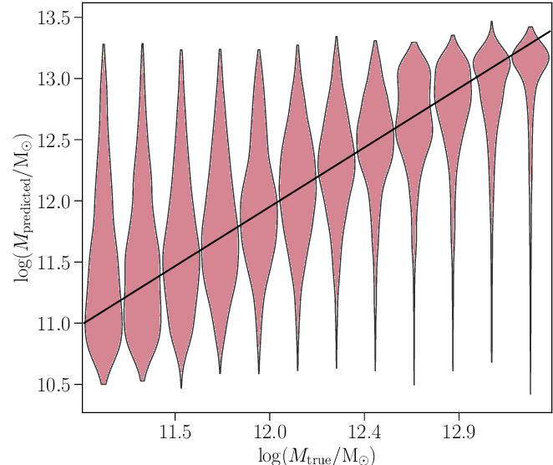
PERFORMANCE
Higher variance for lower mass halos
But the variance is consistent with expectations from analytic models
E.g. Sheth-Tormen ellipsoidal collapse model
The maxima of the distributions are in the correct location
from L.Lucie-Smith et al. 2020​

Slide 32
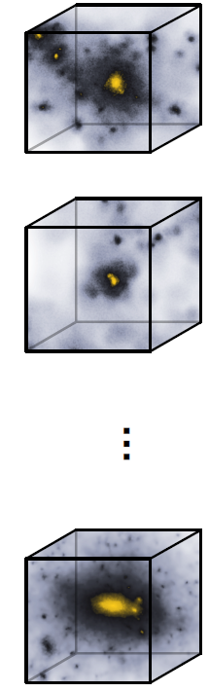
PERFORMANCE
Particles in the innermost regions of the highest-mass halos have the most accurate predictions
Particles in the outskirts of high-mass halos:
Can originate from outside the input sub-box volume
Balance between resolution and box size
Smaller mass halos: particles in different locations have similar variances
from L.Lucie-Smith et al. 2020​

Slide 33
PERFORMANCE
Similar performance to Gradient Boosted Tree (GBT) model from previous work
Quantified using the Kullback-Leibler (K-L) divergence
But, GBT was only fed average density over spheres
from L.Lucie-Smith et al. 2020​

Slide 34
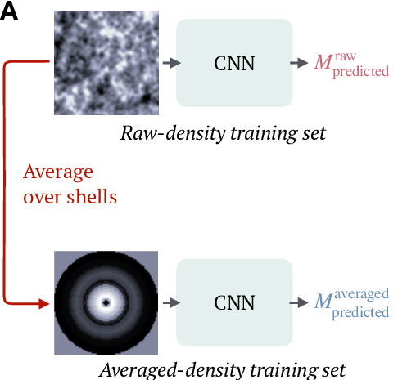
interpretation
Retrained network using spherically averaged input data
Saw little/no decrease in performance
"Learned" info must be equivalent to spherical densities
from L.Lucie-Smith et al. 2020​
Notes:
Unsurprising, given the similar performance to GBT

Slide 35
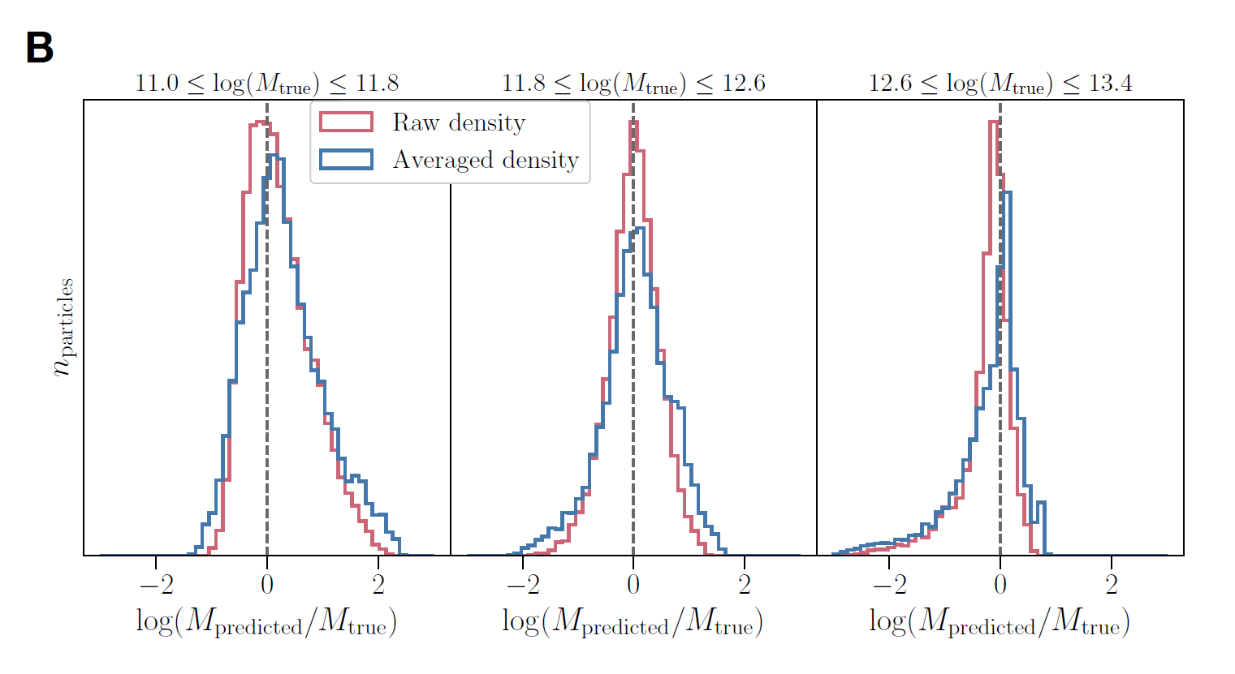
from L.Lucie-Smith et al. 2020​
Notes:
Unsurprising, given the similar performance to GBT

Slide 36
interpretation
Traditional approaches to gravitational collapse emphasize the importance of tidal shear for halo collapse
E.g. ellipsoidal collapse model, “peak-patch” theory
This work (along with previous GBT) shows that anisotropic information does not contribute significantly to the final halo masses
Re-evaluation of the current understanding of gravitational collapse!

Slide 37
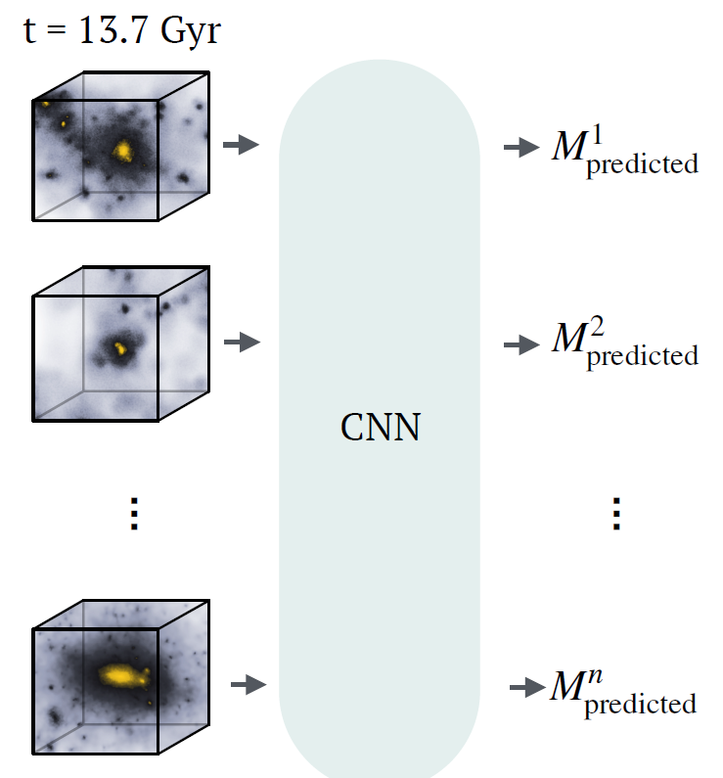
interpretation
How do we know if the CNN is learning features across different scales?
Retrained the network to identify dark matter halos
Input = final density field
Output = mass of the halo the particle is in
from L.Lucie-Smith et al. 2020​
Notes:
Unsurprising, given the similar performance to GBT

Slide 38
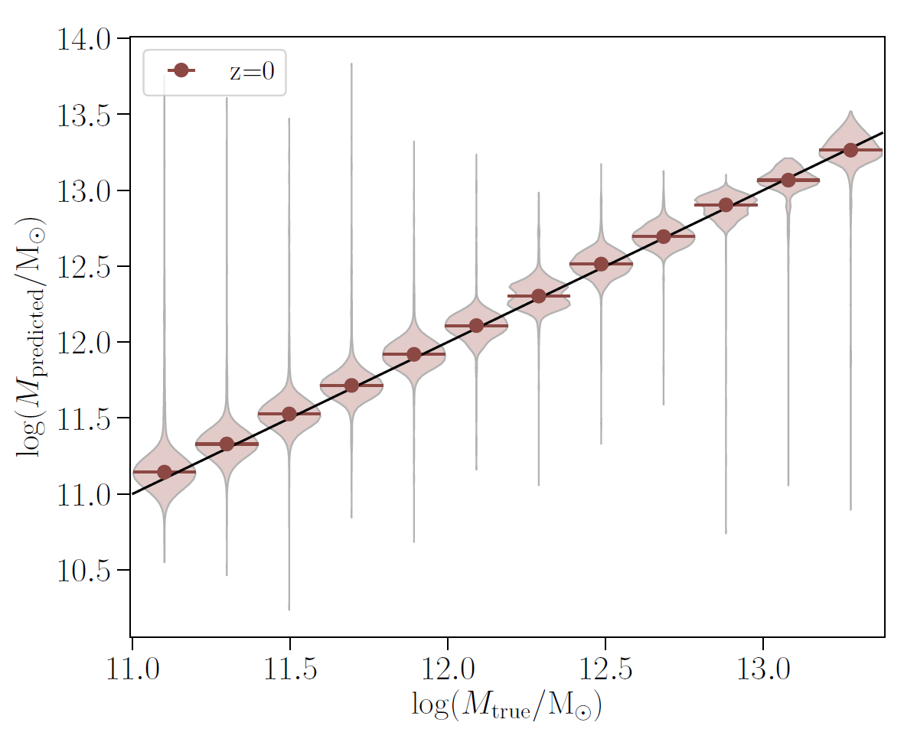
L.Lucie-Smith et al. 2020​
Good agreement: correlation coefficient 𝑟 = 0.96
Predictions are highly accurate throughout the full mass range of halos
Notes:
For predictions at z = 0

Slide 39
4 | Roadmap

Slide 40

Code
Authors' code available at: https://github.com/lluciesmith/DeepHalos
Written in TensorFlow 1.14
Simulation data on Google Cloud
Notes:
Code available on GitHub
Will need to convert from tf to pt
Data hosted on google cloud (obtained from lead Author)

Slide 41

Next steps
Will focus on paper's central result: Predicting halo mass from IC using 3D CNN
Making use of authors' data & hyperparameter values will allow more time for experimentation
Notes:
Focus on predictive result rather than effect of including/removing anisotropies from inputs.
Will make use of their data, hyperparameter values to allow more time for

Slide 42

workflow
Write data loader to handle simulations / ICs + labels for thousands of particles
Convert TensorFlow architecture into PyTorch
Debug, train, and test model
Try variations/extensions (time permitting)

Slide 43
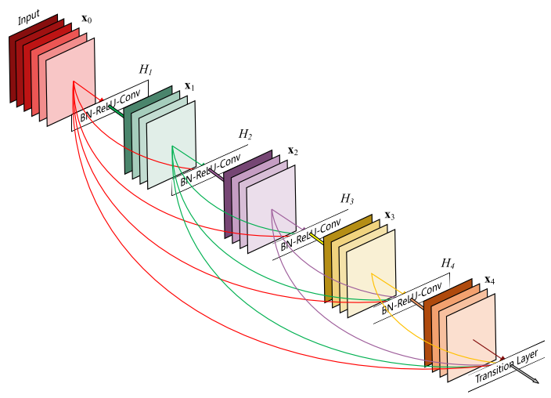
Extensions
Modify network architecture: Adjusting optimizer, adding skip connections, etc. (those not attempted by authors)
Incorporate a variational auto-encoder
Applying to other halo traits: spin, shape, peculiar velocity
Figure: ResNet architecture (https://towardsdatascience.com/an-overview-of-resnet-and-its-variants-5281e2f56035)

Slide 44

resources
Tested on Nvidia Tesla P100 and V100 GPUs
Reproducing entire work would be computationally expensive
Author recommends using subset of data for time reasons
Plan to use half the simulations

Slide 45
Potential setbacks
Translation step from TensorFlow may present issues
Custom Cauchy loss function has many terms & could be difficult to implement
Need to optimize 𝛾
Dataset is large, we expect long training times
Authors performed 35 000+ training iterations (~ 3 000 epochs)
Need for computational resources

Slide 46
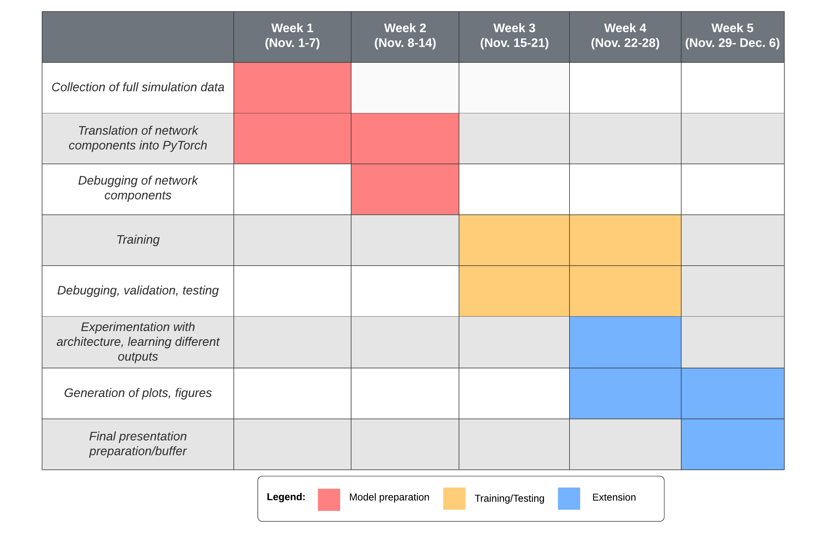

Slide 47
THANK YOU

Slide 48
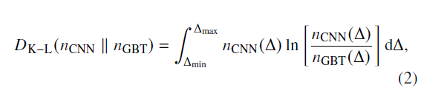
K-l divergence

